Slide 1
HireIt
Ruby On Rails marketplace App
By: Roba Elshazly

Slide 2
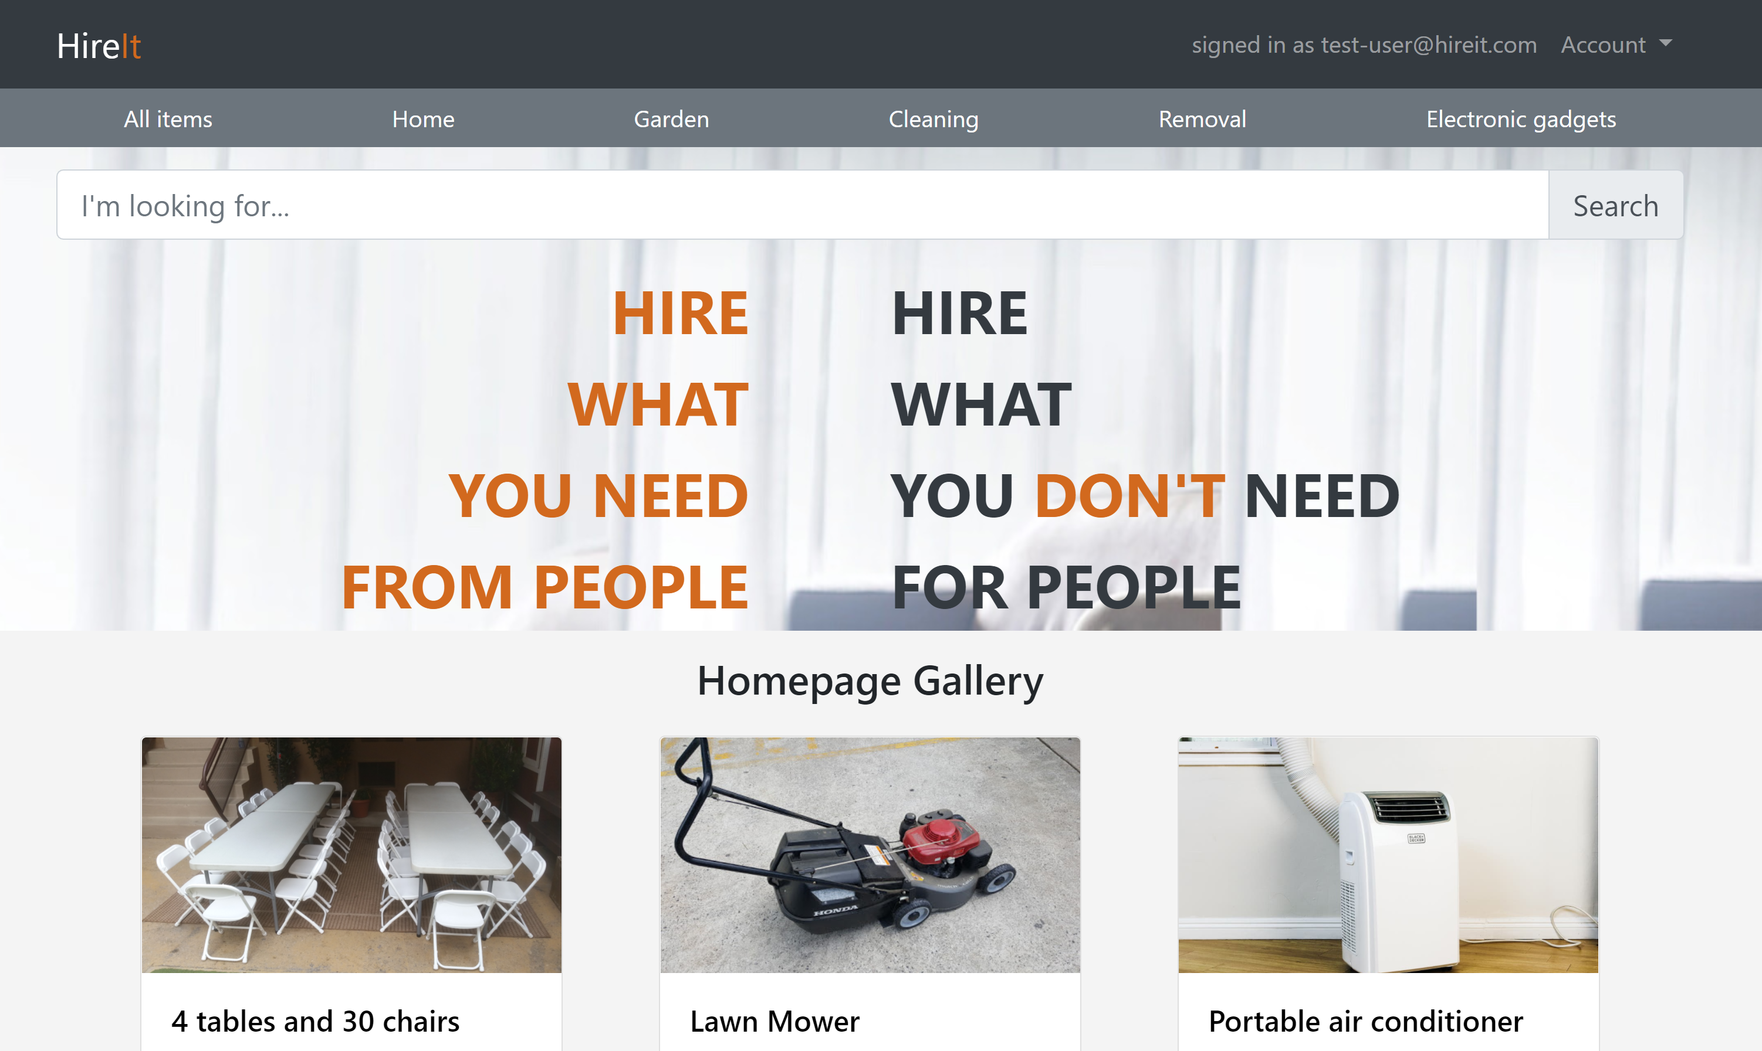
About The App:
The app purpose is to enable people to hire items they need from people , or hire items they own for other people.

Slide 3
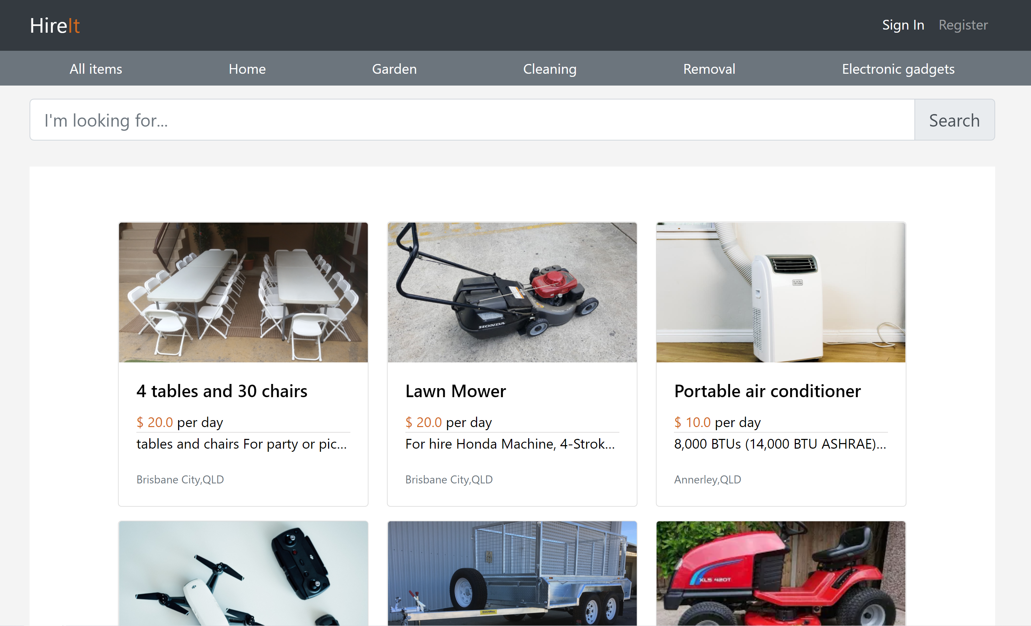
Users can browse items for hire by other people without needing to log in.

Slide 4
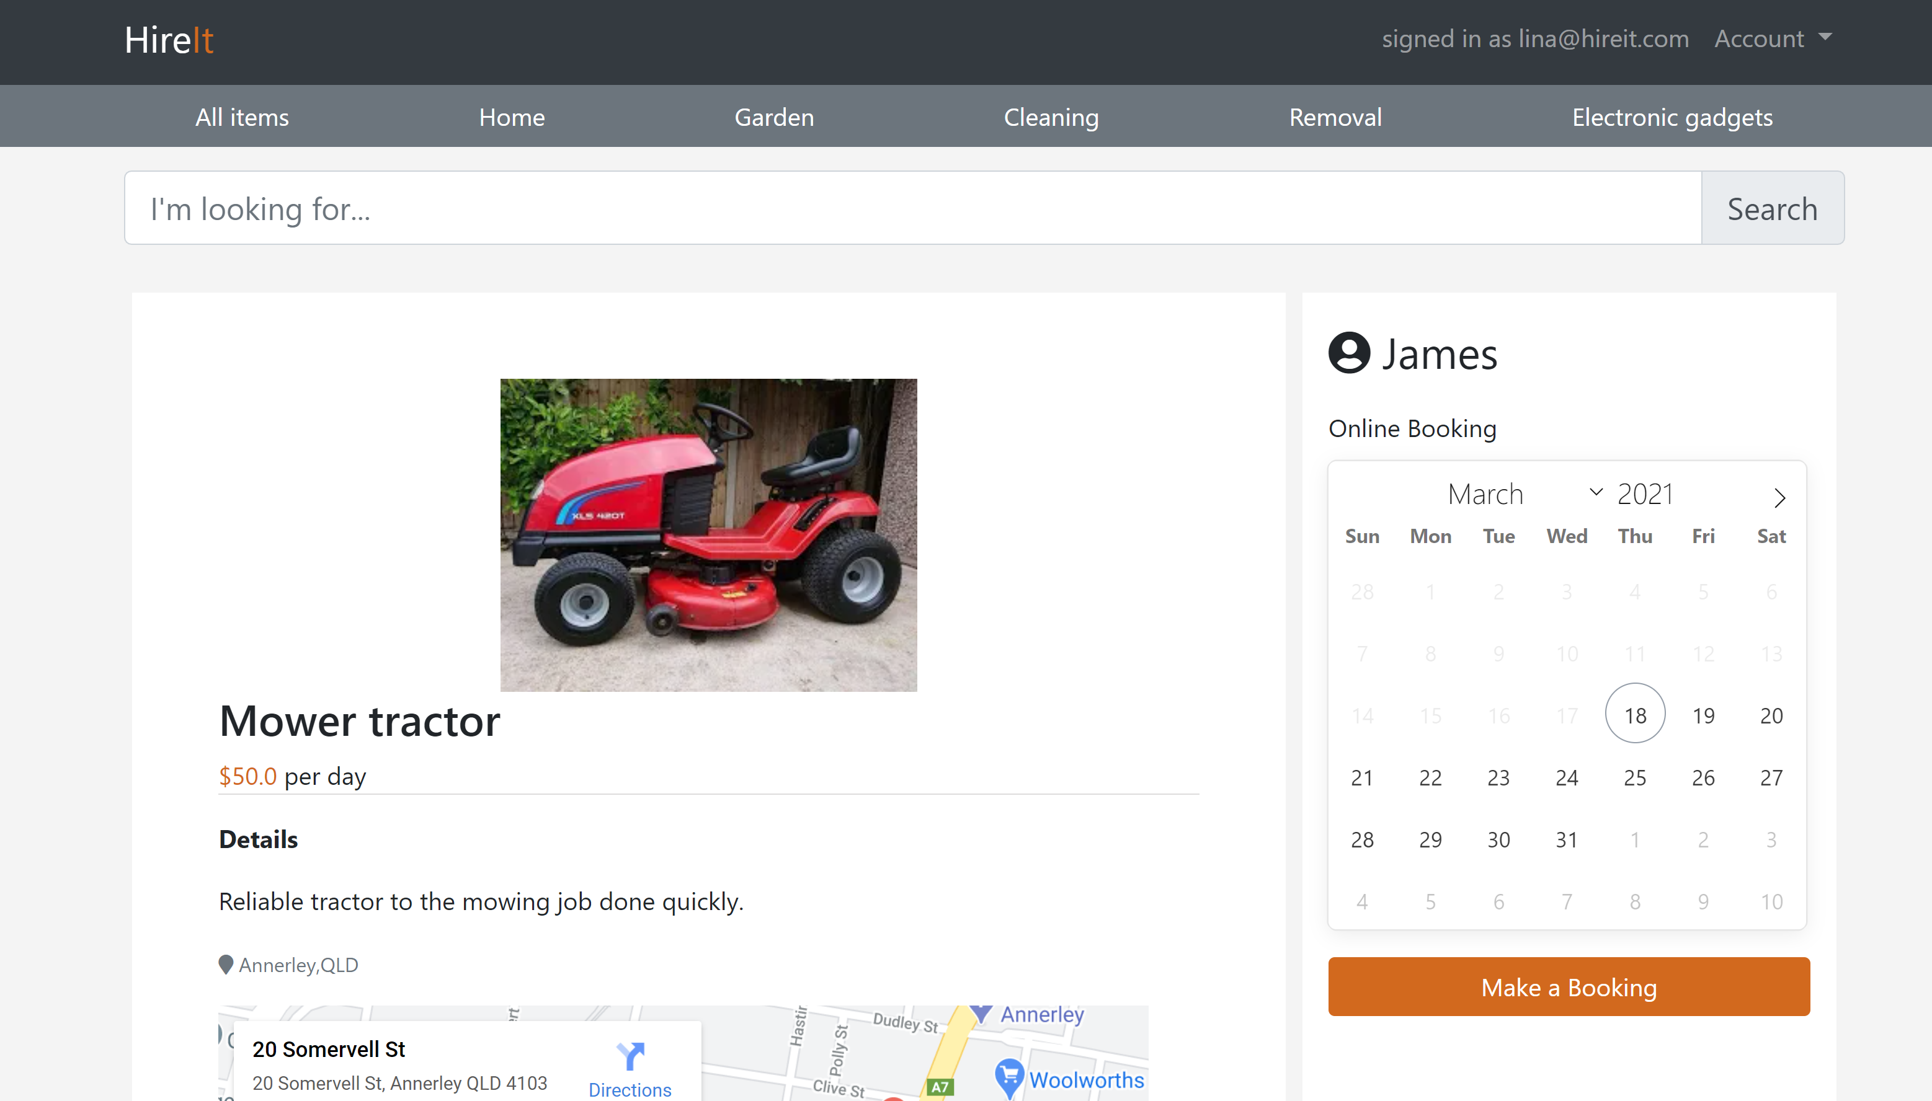
Users can view an item and check available dates , without needing to log in. “Make a booking” button directs the user to log in if not logged in, otherwise to checkout

Slide 5
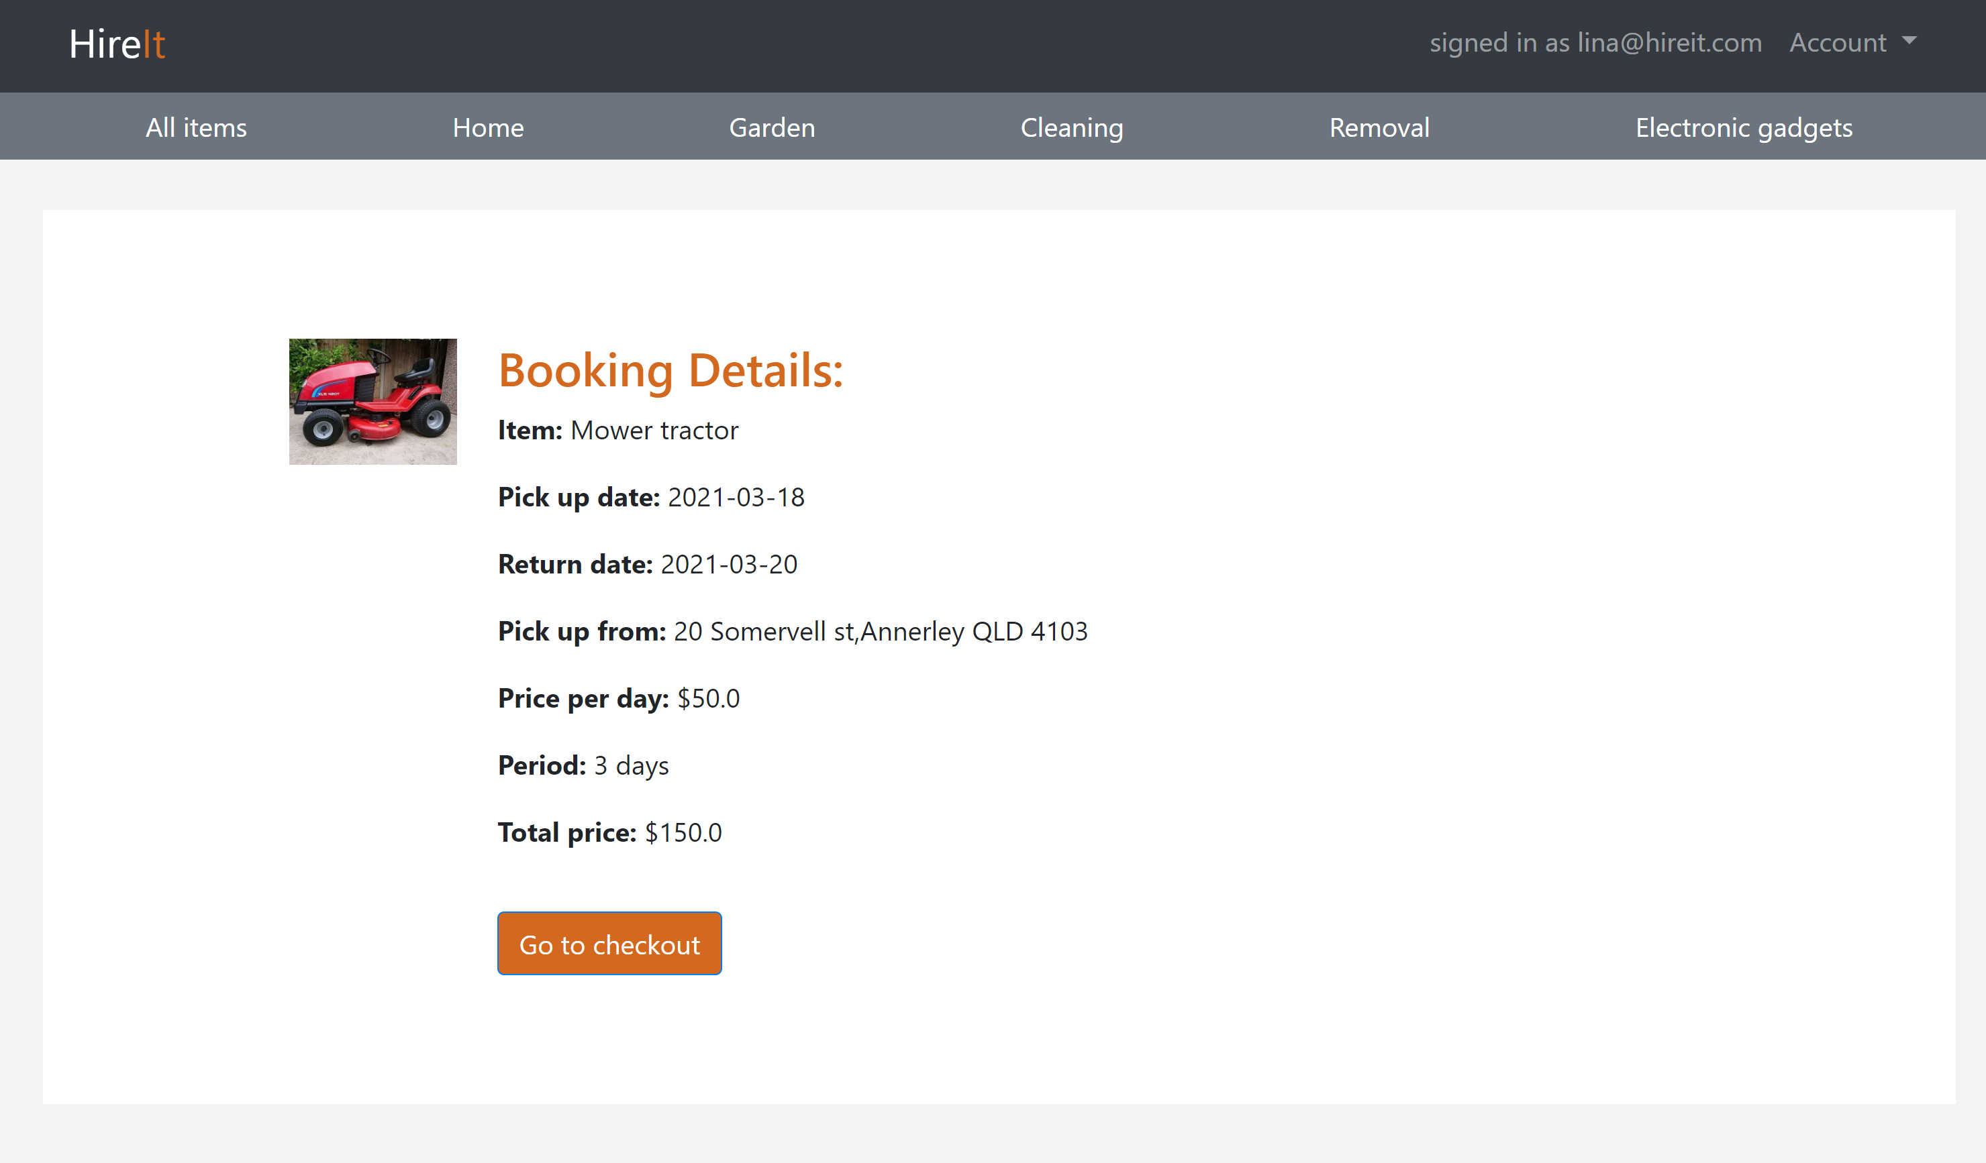
A user can check the booking details before payment

Slide 6
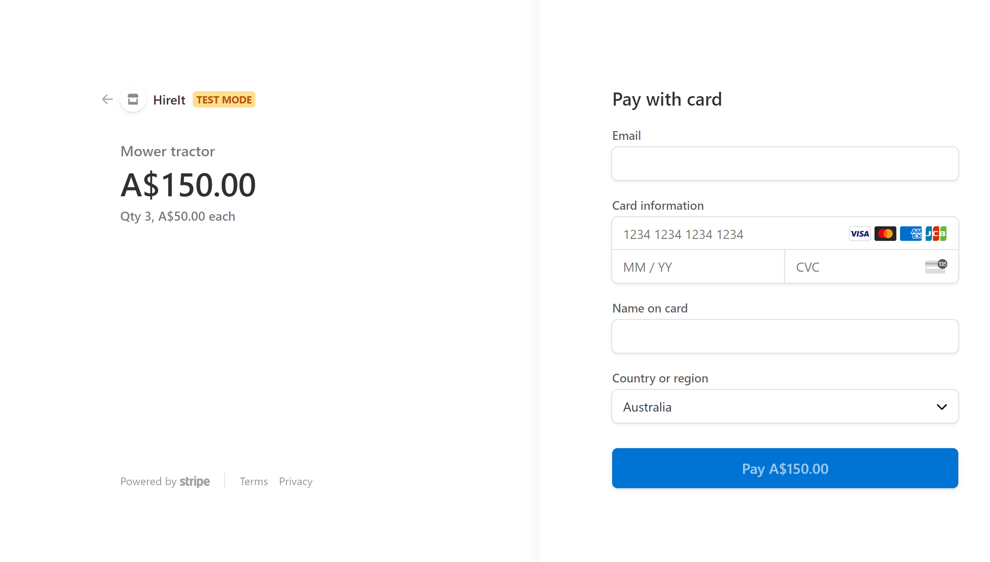
The user is then directed to checkout page.

Slide 7
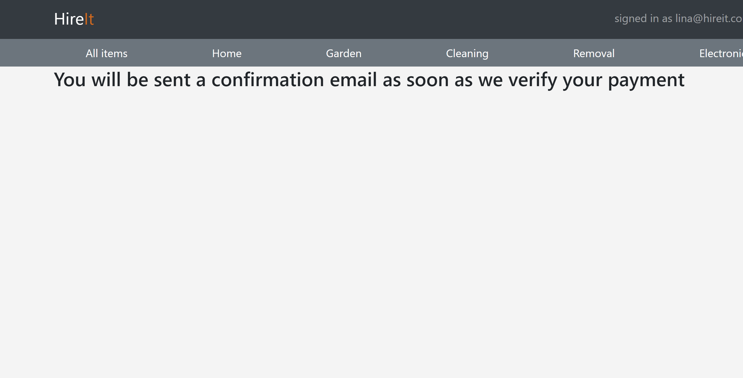
The user will be sent a confirmation email as soon as the payment is verified by the webhook.

Slide 8
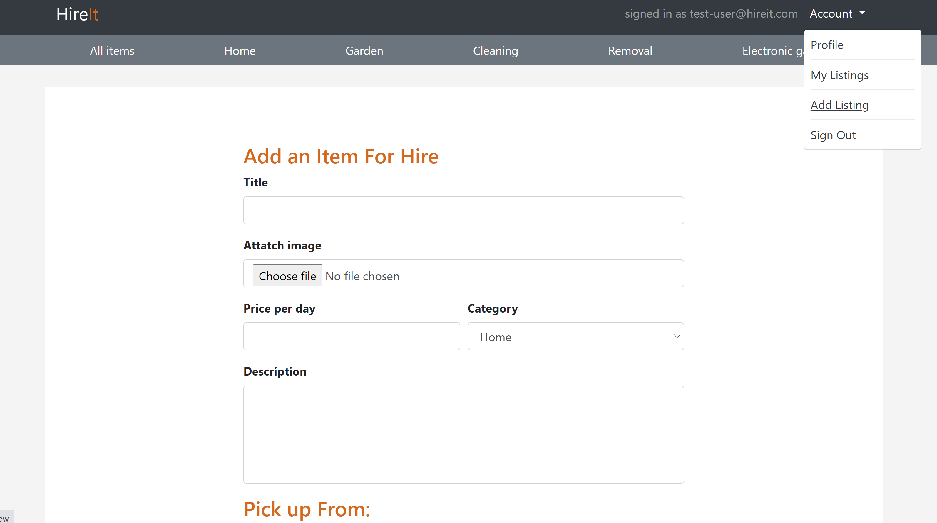
Users also can hire items by adding their items for hire.

Slide 9
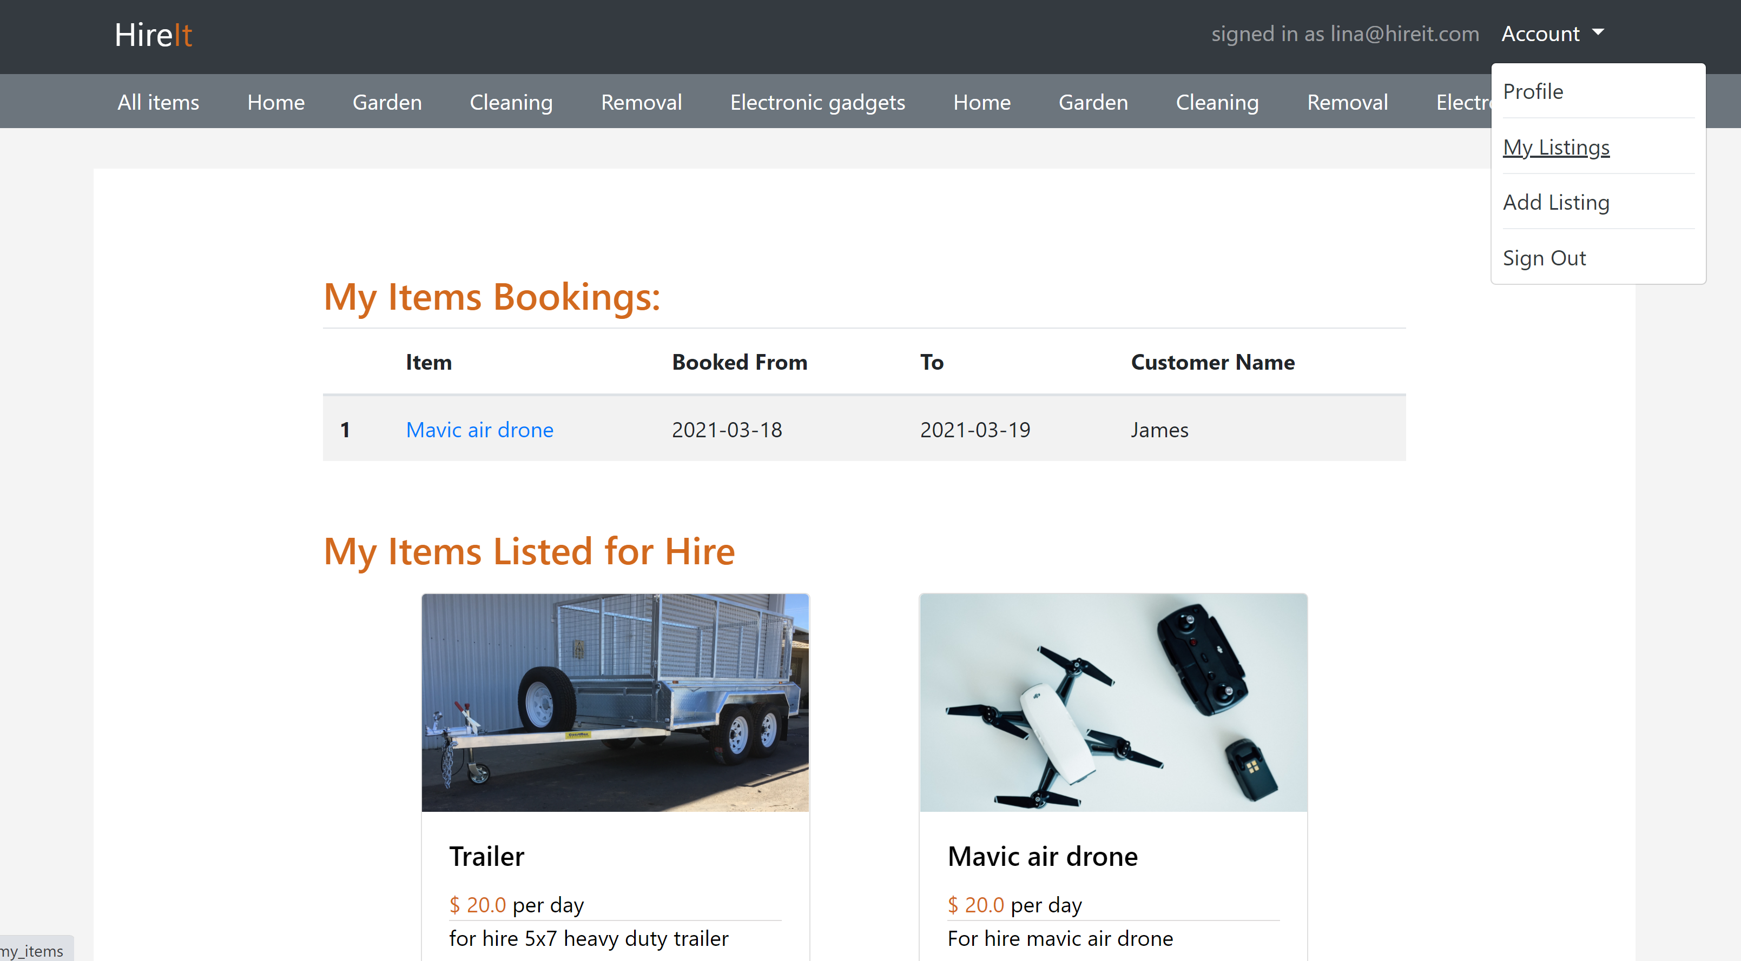
The users can view their items listed for hire to manage them, and also check bookings made to their items.

Slide 10
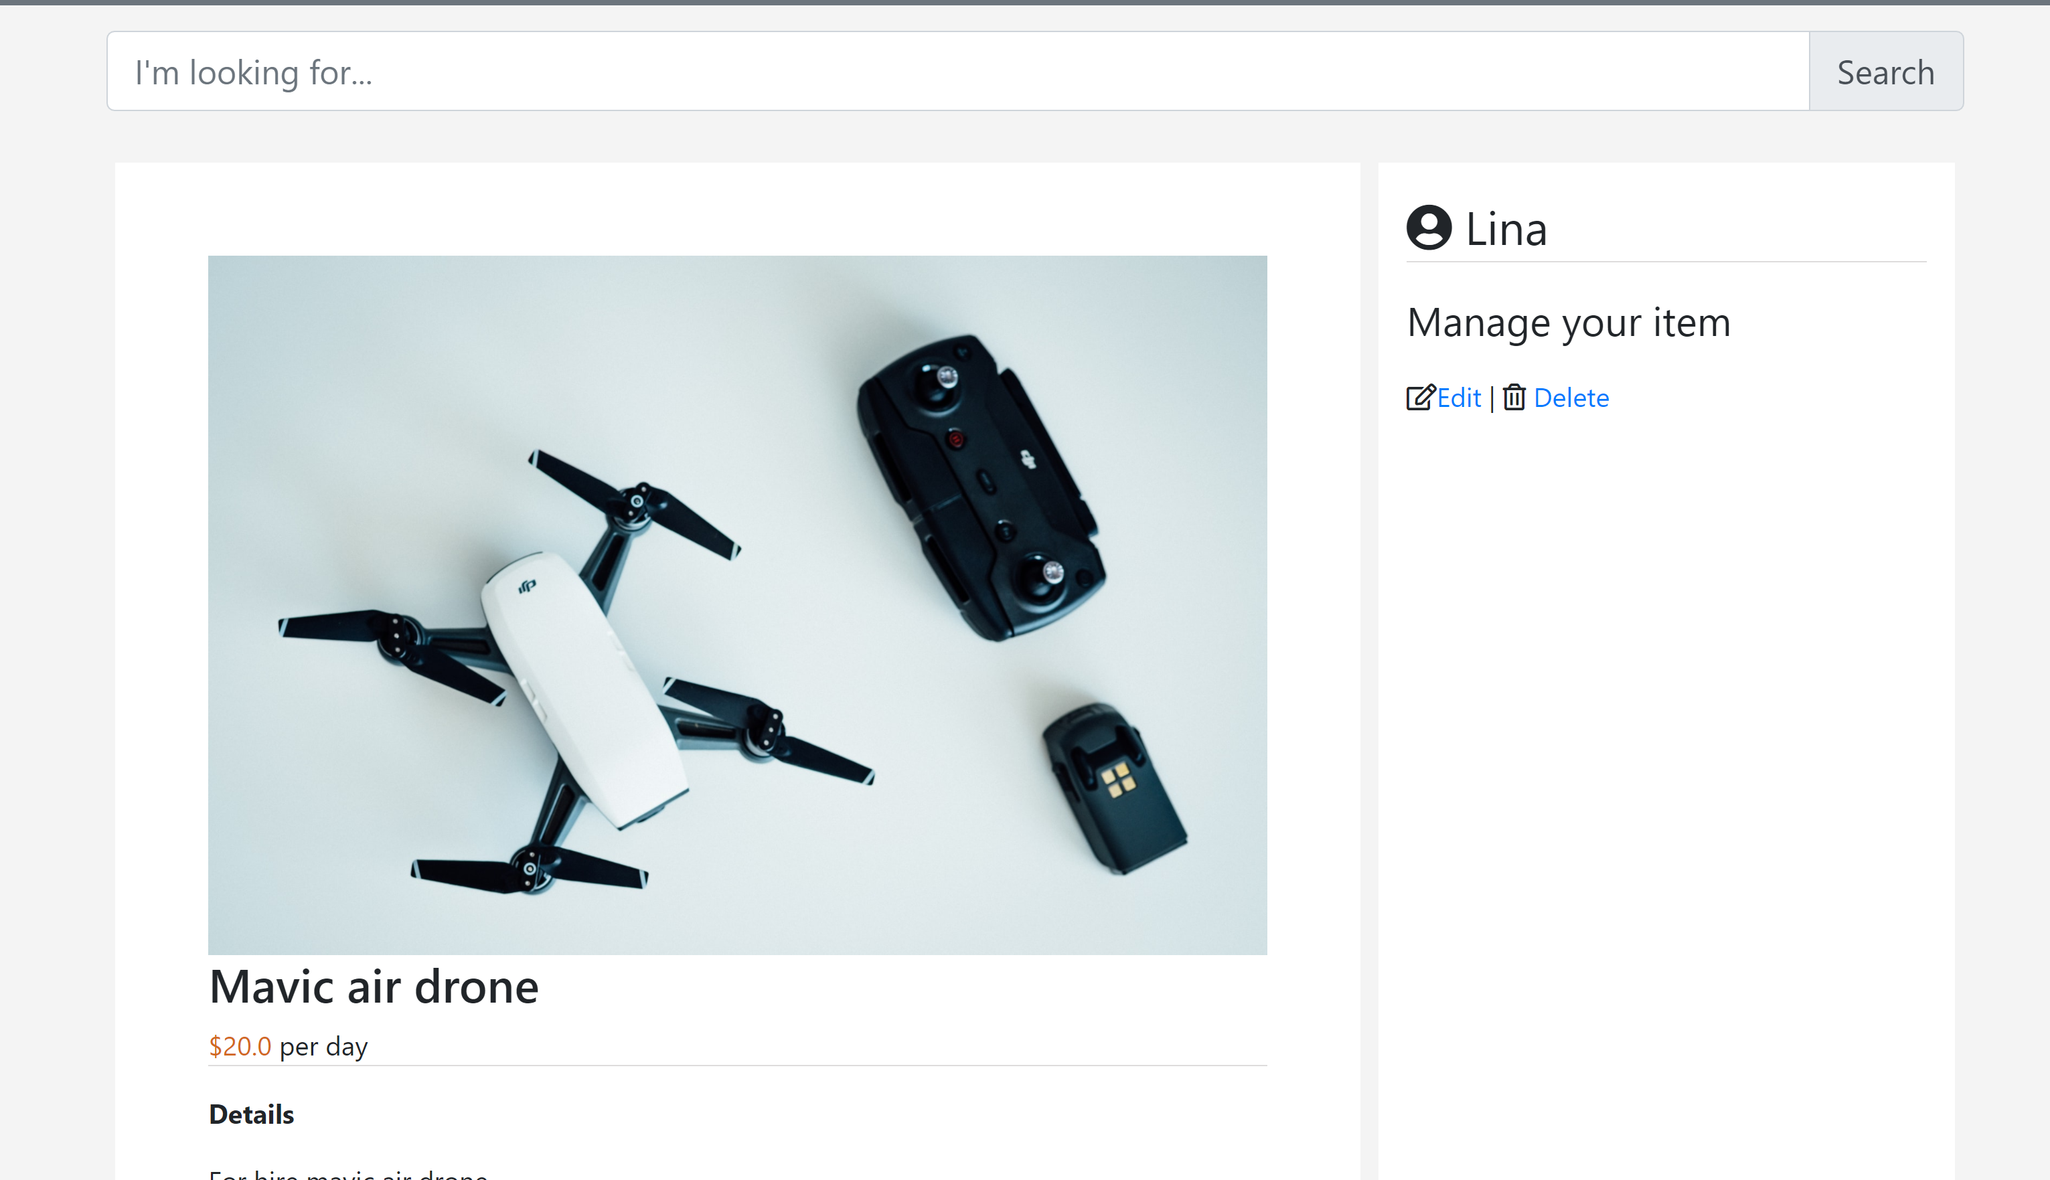
Users can edit their items and delete them by viewing an item

